Slide 1
BIOMARKER

Slide 2
Maturity
Thermal maturity heat-driven reaction converts sedimentary organic matter into petroleum. In the same way, certain biomarkers have been used to characterize source materials and depositional environments. Selected biomarkers have been used to evaluate the relative maturity of suspected source rocks and the oils that may have generated (Philip, 2007). The commonly used parameters used as biomarkers are summarized below:

Slide 3
%Tricyclic terpanes/ (Tricyclics + 17αHopanes)
%βα/(αβ+βα-Hopanes (C30))
%Ts/(Ts+Tm)
18β/(α+β).oleananes
%20S/(20S+20R)-steranes (C29)
%22S/(22S+22R)-Hopanes (C32)
%ββ/(ββ+αα)-steranes (C29)
%Diasteranes/(Diasteranes+regular steranes)
%TA(I)/TA(I+II)
Moretanes/Hopanes
Ts/Hopanes

Slide 4
12. C29 Ts/(C29 hopane + C29Ts)
13. (BNH/TNH)/hopanes
14. C26 Triaromatic 20S/(20S + 20R)
15. Other parameters are non-biomarkers.
Maturity parameters of oil sample can be used to assess the relative level of thermal maturity (Peter et al., 2005). The more commonly non-biomarker maturity parameters are:
Isoprenoid/ n-alkane ratio
Carbon preference index (CPI)
Odd-to-even predominance (OEP)
Methyl phenanthrene index
While not all of the maturity parameters will be discussed in details, it is useful to make short comment concerning most commonly used ones

Slide 5
1. Tricyclic / 17αHopanes (C19-C25T)/(C29-C33H)
The increaseing of tricyclics/17αH-ratio leads to increase oil thermal maturity (Seifert and Moldowan, 1978). From Table (4-2 a) it is obvious that this ratio for all samples of crude oil is high indicating that oils are mature.
2. 22S/(22S+22R)
Homohopane isomerization typically using the C31 or C32 homologs the 22S/(22S+22R) ratio rises from 0 to 0.6 (0.57 – 0.62 = equilibrium) (Seifert and Moldowan, 1980). During maturation the range of ratio (0.5 – 0.54) has barely entered oil generation, while ratios in the range (0.57-0.62) indicate that the main phase of oils generation has been reached or surpassed (Peters et al., 2005). The values of 22S/(22S+22R) for C31 and C32 in Table (4-2) for all samples of crude oil and oil extracts indicate that oil of the study area is above early oil generation.
3. Ts/(Ts+Tm)
Thermal parameter based on relative stability of C27 hopanes applicable over the range immature to mature to postmature, but with strong dependence on source, also expressed as Ts/Tm (Peters et al., 2005). Ts is more stable than Tm and degrades less during diagenesis and catagenesis. Thus, the ratio is an indicator of the maturity of the rock (Isaken, 2004).
As seen from Table (4-2) and Fig. (4-10 a, b) value of Ts/Tm of all samples of crude oils and oil extracts are moderate to high maturity.

Slide 6
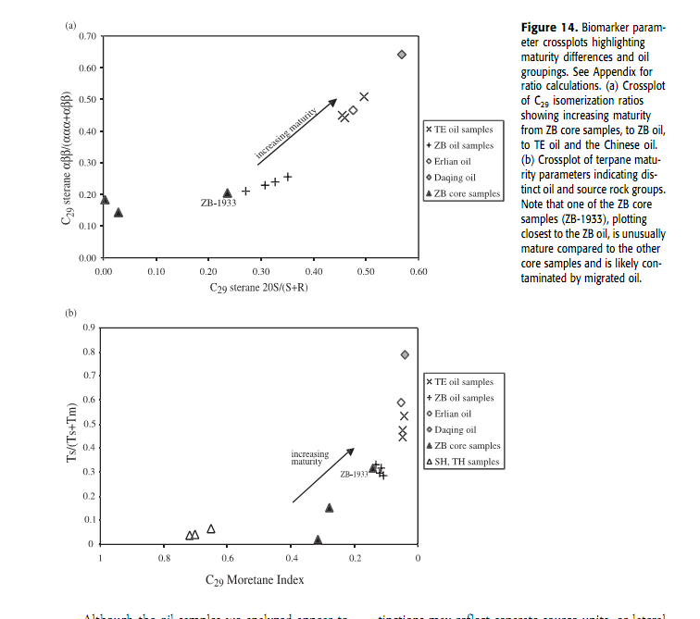

Slide 7
4. 18β/(α+β)- oleananes and oleanane index (immature to early mature range)
There is no oleananes in all samples of crude oils and rock extracts.
5. 20S/(20S+20R) Isomerization
Steranes – isomerization stereochemical conversions between biological and geological configuration at several a symmetric centers, which are used as an indicatorof thermal maturity includes 20S/(20S+20R) and ββ/(ββ+αα) parameters (Peters et al., 2005). Isomerization at C-20 in the C29 5α, 14α, 17α(H)-steranes causes 20S/(20S+20R) to rise from to approximately 0.5 (0.52-0.55 = equilibrium) with increasing thermal maturity (Seifert and Moldowan, 1986). The ratio of steranes isomerization ranges between (0.47 – 0.73) that at or above peak oil generation in all sample of crude oils and medium to high maturity oils.
6. Ts/Hopane
Volkman et al. (1983) proposed Ts/(C30 17α-H) as a maturity parameter for every mature oils and condensates. All samples of crude oils have Ts/H values ranges from (0.08-0.15) indicating early to peak oil generation except one 0.24 (Zubair Formation in NR-1) at above peak oil generation (Table 4-2). The rock extracts of the study area have value of Ts/H between peak oil generation to above peak oil.

Slide 8
7. Moretanes/hopanes
High specificity for immature to early oil generation using C29 or C30 homologs (Peters et al., 2005). The 17β, 21α(H)-moretanes are thermally less stable than the 17α, 21β(H)-hopanes and be abundance of the C29 and C30 moretanes decrease relative to the corresponding hopanes with thermal maturity, the ratio decreases with thermal maturity (Peters et al., 2005). The value of this ratio, Table (4-2) for crude oils and rock extracts is less than 0.1 revealing that oil of the study area is mature, Fig. (4-10 a, b).
8. C29 Ts/(C29 hopanes) + C29 Ts)
18α-30 Norneohopanes (C29 Ts) abundance relative to the 17α-hopane is related to thermal maturity (Hughes et al., 1985). The thermal maturity effect on the C29 Ts/(C29 17α-hopane + C29 Ts) ratio should be comparable with but slightly less than that on Ts/(Ts+Tm) (Peters et al., 2005). Both parameters increase with thermal maturity as indicated by other marker parameters (Fowler and Brooks, 1990). In Table (4-2) the values of these parameters show that all sample have values indicating moderate maturity except the Zubair Formation in Nahr Umr-7 field which has high maturity.

Slide 9
9.(BNH+TNH)/hopanes (also express as C28/C30 hopanes)
The ratio is defined as (28, 30-bisnorhopanes + 25, 28, 30-trisnorhopanes) /(C29+C30 17α-hopanes) (Moldowan et al., 1984). The ratio decreases with thermal maturity, Table (4-2). All samples of crude oils and rock extracts have few values of this ratio indicating that all samples are mature.
10. 20S/(20S+20R) Steranes
C29 [20S/(20S+20R)-C29ααα cholestane was found to be ranges between (0.47-0.73) in crude oils and (0.13-0.87) for rock extracts of study area which may revealing that oils at or above peak oil generation of thermal maturity, Table (4-2).
11. Diasteranes/Steranes
Thermal maturity lithology, and the redox potential of the source-rock deposition environment affect diasteranes/steranes (Peters et al., 2005). As a result, this ratio is useful for maturity determination only when the oil or bitumens being compared are from the same source-rock organic facies (Peters et al., 2005). Alternatively, heating in the post mature range induced destruction of biomarkers, and increased diasteranes/steranes might indicate better survival diasteranes under high temperature conditions (Peters et al., 2005). The ratio of diasteranes/steranes shown in Table (1) suggests that maturity at peak oil window (%Ro) for all samples of crude oil and rock extract.

Slide 10
12.TA(I)/TA(I+II)
It is commonly used for maturity. This ratio increases with thermal maturity. The
13. C26 triaromatic 20S/(20S+20R)
Highly specific for mature to highly mature ring C26 triaromatic 20S/(20S+20R) is more sensitive at higher levels of maturity than either C29 sterane ratio (Peters et al., 2005). The 20S/(20S+20R) ratio for the C27 and C28 triaromatic steroids shows trend similar to those for C26 triaromatic steroids with maturity. Although they are more erratic (Peters Moldowan, 1993).
14. Isoprnoid/ n-alkane ratios
They are specific for maturity, but also affected by other processes such as source and biodegradation (Peters et al., 2005). Pristane/n-C17 and phytane/n-C18 decrease with thermal maturity as more n-alkanes are generated from kerogen by cracking (Tissot at al., 1971) the ratios of Pr/n-17 and Ph/n – C18 shown in Table (4-2) indicate that all samples of crude oil are mature.
15. Carbon preference index and odd to even predominance (CPI and OEP)
CPI and OEP value significantly [(odd preference) {even preference)] one indicates low maturity oils from carbonate or hypersaline environments (Peters et al., 2005). CPI and OEP values of the study area indicate medium maturity for all samples of crude oil and rock extract, Table (4-2).

Slide 11
16.Aromatic maturity indicators
Many maturity parameters are available based on the distribution of certain methylated aromatic hydrocarbons (Philip, 2007). There are many parameters for aromatic ratios:
a)Methyl phenathrene index (MPI)
One commonly used set of ratios is based on methylphenanthrene indices which has been shown in some cases to be similar or superior to vitrinite reflectance values (Radke et al., 1982). This ratio is written as (Cannan et al., 1988):

Slide 13
MPI depends on organic facies but is generally most reliable for petroleum generated from type kerogen III (Philip, 2007). The difficulties may be converting our maturity measurements to vitrinite reflectance equivalents (Cannan et al., 1986). The phenanthrene 9- and 1-methyl phenanthrenes decrease relative to 3- and 2- methyl isomers with increasing maturity (1.3% R_{o}) (Cannan et al., 1986). Consequently, MPI and MPI3 increase with maturity. According to above the MPI of crude oil and rock extract samples of the study area range between 0.649 to 0.940 with average value of 0.77 suggesting that the maturation stage of these samples ranges from moderate to early mature (i.e., 0.5-0.75 % R_{o}).
b) Methyl dibenzothiophene ratios
Maturity parameters including indices (MDBI1 and MDBI3) is defined by Connan et al. (1986) as

Slide 15
Age dating of crude oils
The biomarkers can be used to constrain the age of the source rocks from which a crude oil was generated (Philip, 2007). The idea behind that is to use compounds that can be correlated with the evolution of certain organisms or plant and whose evolutionary history is known, hence, the appearance of these specific compounds in the crude oils will then constrain the age of the source rocks (Philip, 2007). Moldowan et al. (1996) used various norcholestane to detect age changes and various worker have noted the fact that the oleannanes which can be associated with the evolution of the flowering plants show a significant increase in concentration in oils of tertiary and late Cretaceous age. The following ratios are used to age identification:

Slide 16
Extended tricyclic terpanes ratio
Age related parameter to distinguish Triassic from Jurassic oil samples (Peters et al., 2005). ETR = ((C28+C21)/(C28+C24+TS)) (Holba et al., 2001). Early results suggest that ETR can be used to differentiate crude oil generated from Triassic, lower Jurassic, and Middle-Upper Jurassic source rocks (Peters et al., 2005). The ETR for all sample crude oils in study area have values less than 2 indicated that oils are generated from middle to late upper Jurassic source rocks (see Table 4-1).

Slide 17
C28/C29 steranes
Data indicate a general increase in the relative content of C28 steranes and a decrease in C29 steranes in marine petroleum through geologic time (Moldowan et al., 1985). The increase in C28 steranes may be related to increase diversification of phytoplankton assemblage including diatoms, coccolithophores, and dinoflagellates in the Jurassic and cretaceous periods (Peters et al., 2005). Grantham and Wakefield (1988) observed that C28/C29 steranes is < 0.5 for Paleozoic and older oils, 0.4 – 0.7 for upper Paleozoic to lower Jurassic oils and greater than 0.7 for upper Jurassic to Miocene oils. The ratio of this index for crude oil of the study is between 0.4 – 0.7, Table (4-1).
Biomarkers indicate the biological source of organic matter in the all samples of crude oils are marine algae and bacteria which deposition in anoxic conditions of deep water marine (depth >150 m). This may indicate that the age of source rocks is upper Jurassic- lower Cretaceous (Sulaiy Formation and possibly Yamama Formation).

